Slide 1
Cookbook for Practice 2.2
实践2.2攻略
Cong Li 李聪

Slide 2

Rote Learning 死记硬背 (1)
Start a new file ‘roteLearner.py’ w/ a new class
创建一个包含新的类型的新文件“roteLearner.py”
We will use a member variable to memorize the training data. So we initialize it in the initialization function & assign its value in a member function for training
我们将用一个成员变量记录训练数据。因此我们在初始化函数中对其初始化，并在一个用于训练的成员函数中对其赋值

Slide 3

Rote Learning 死记硬背 (2)
Since we need to loop over all the items in the training data for matching, we go to the class ‘USPSData’ & add a member function to return the number of items
由于我们需要遍历所有的训练数据进行匹配，因此我们在“USPSData”类型中加一个成员函数，返回训练数据的数量

Slide 4
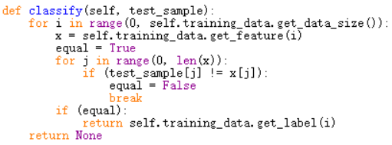
Rote Learning 死记硬背 (3)
Now we complete the classification in ‘roteLearner.py’
现在我们在“roteLearner.py”中完成分类
Get the ith training data item & match w/ it
取出第i条数据并对其进行匹配

Slide 5


Evaluation 评估 (1)
Start a new file ‘tester.py’ w/ a class, put in a classifier in initialization 开启一个新文件“tester.py”和一个新类型，将一个分类器作为参数进行初始化
Add another member function to train the classifier w/ a training data file 加一个成员函数，用训练数据文件对分类器进行训练

Slide 6
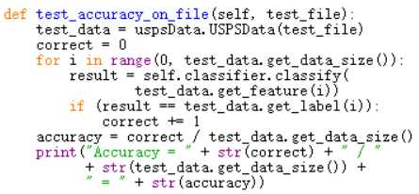
Evaluation 评估 (2)
Use a member function to test the classifier w/ a test data file
用一个成员函数，以一个测试数据文件对分类器进行测试
Check the result of classifying each data item
对每条数据的分类结果进行检查

Slide 7
Evaluation 评估 (2)
Use a member function to test the classifier w/ a test data file
用一个成员函数，以一个测试数据文件对分类器进行测试
Calculate & output the accuracy
计算并输出准确率

Slide 8
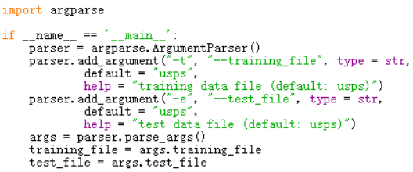
Run It 运行之 (1)
Start a new file ‘test.py’ w/ a main section & accept 2 arguments for training & test data file
写一个带main部分的新文件“test.py”，接受训练和测试数据文件这两个参数，

Slide 9


Run It 运行之 (2)
Import the files written 导入新写的文件
Create the instances for the class ‘RoteLearner’ & ‘Tester’, & then perform the evaluation on the training & testing files 为类型“RoteLearner”和“Tester”创建实例，用训练和测试数据文件对死记硬背进行评估
Try to train on ‘usps’, test on ‘usps’ & ‘usps.t’
尝试用“usps”进行训练，用“usps”和“usps.t”进行评估

Slide 10
The End

